Slide 1

ANP-C9180
Assignment
AF0438100 Chirag Sharma

Slide 2
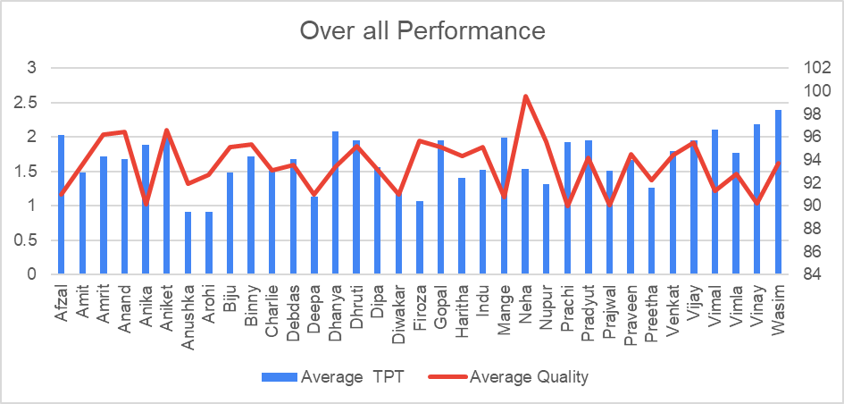
AVG TPT & QUALITY
Based on 30 days data
THE AVG. TPT IS 1.66, AVG. QUALITY IS 93.5, STDDEV. TPT IS 0.26 AND STDDEV. QUALITY IS 1.38 FOR ALL THE 30 DAYS

Slide 3
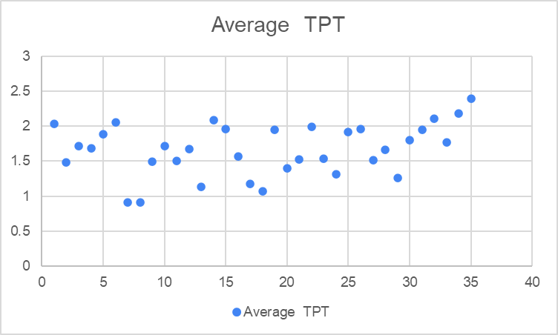
CHARTS
Based on 30 days data

Slide 4
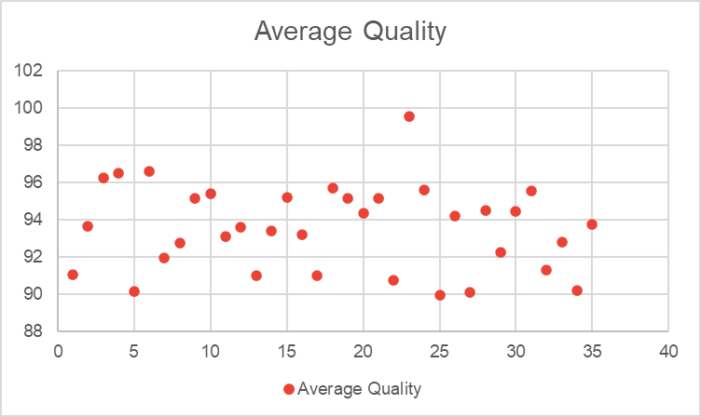
CHARTS
Based on 30 days data

Slide 5
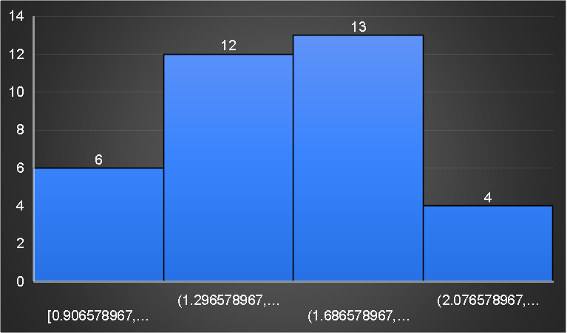
CHARTS
Based on 30 days data

Slide 6





# 1
We can check every individual person performance with help of avg, tpt and avg. quality of the performance
Based On Analysis
# 2
Based on measure of performance, we can find member who are no performance is not that good.
3
It will them to findout which member want more traning to complete the task in givebn time.

Slide 7

Thank
YOU

